Slide 1
Sunday, August 30 - PM
Right Doctrine – Right Living - Introduction
Titus 1:1-4 (Part 1)

Slide 2
Right Doctrine – Right Living – Titus
Titus 1:1-4
1 Paul, a bond-servant of God and an apostle of Jesus Christ, for the faith of those chosen of God and the knowledge of the truth which is according to godliness, 2 in the hope of eternal life, which God, who cannot lie, promised long ages ago, 3 but at the proper time manifested, even His word, in the proclamation with which I was entrusted according to the commandment of God our Savior, 4 To Titus, my true child in a common faith: Grace and peace from God the Father and Christ Jesus our Savior.

Slide 3
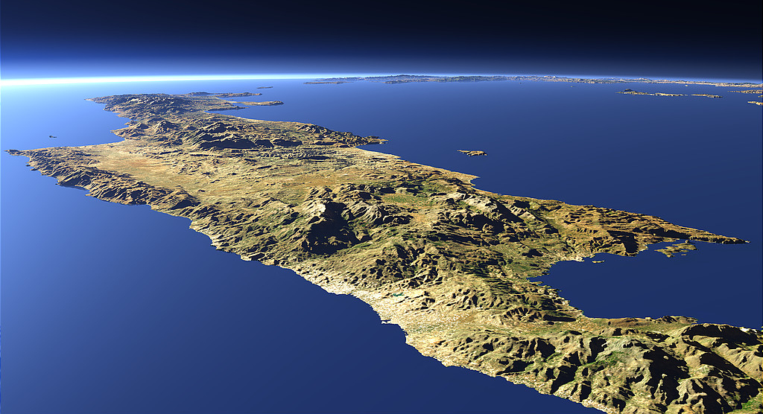

Slide 4
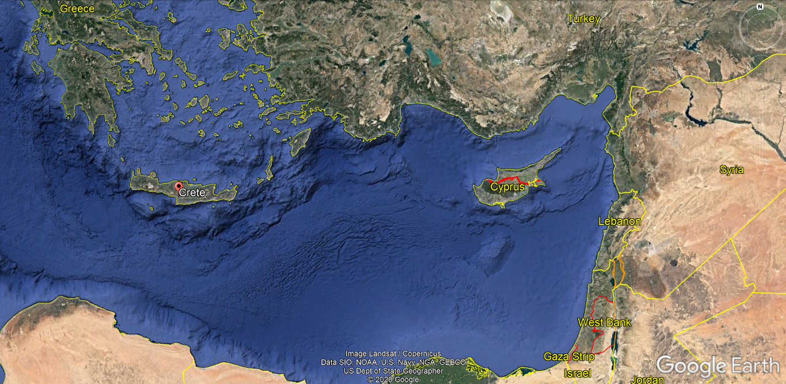

Slide 5
Right Doctrine – Right Living
Right Doctrine – Right Living
Living godly in the present age (Titus 2:12) requires being:
Saved by the grace of God;
Engaged in good deeds to the glory of God;
Committed to the Church of God.

Slide 6
Right Doctrine – Right Living
Right Doctrine – Right Living
Living godly in the present age requires being saved by the grace of God.

Slide 7
Right Doctrine – Right Living – Titus
Romans 5:20-6:2
20 The Law came in so that the transgression would increase; but where sin increased, grace abounded all the more, 21 so that, as sin reigned in death, even so grace would reign through righteousness to eternal life through Jesus Christ our Lord. 6:1 What shall we say then? Are we to continue in sin so that grace may increase? 2 May it never be! How shall we who died to sin still live in it?

Slide 8
Right Doctrine – Right Living – Titus
Titus 1:1-4
1 Paul, a bond-servant of God and an apostle of Jesus Christ, for the faith of those chosen of God and the knowledge of the truth which is according to godliness, 2 in the hope of eternal life, which God, who cannot lie, promised long ages ago, 3 but at the proper time manifested, even His word, in the proclamation with which I was entrusted according to the commandment of God our Savior, 4 To Titus, my true child in a common faith: Grace and peace from God the Father and Christ Jesus our Savior.

Slide 9
Right Doctrine – Right Living – Titus
Ephesians 2:4-5
4 But God, being rich in mercy, because of His great love with which He loved us, 5 even when we were dead in our transgressions, made us alive together with Christ (by grace you have been saved),

Slide 10
Right Doctrine – Right Living – Titus
2 Corinthians 4:3-6
3 And even if our gospel is veiled, it is veiled to those who are perishing, 4 in whose case the god of this world has blinded the minds of the unbelieving so that they might not see the light of the gospel of the glory of Christ, who is the image of God. 5 For we do not preach ourselves but Christ Jesus as Lord, and ourselves as your bond-servants for Jesus' sake. 6 For God, who said, "Light shall shine out of darkness," is the One who has shone in our hearts to give the Light of the knowledge of the glory of God in the face of Christ.

Slide 11
Right Doctrine – Right Living
Right Doctrine – Right Living
Living godly in the present age requires being saved by the grace of God.
Salvation is from the Lord; not from men (See Jonah 2:7-9; Psalm 3:8; Revelation 19:1)

Slide 12
Right Doctrine – Right Living – Titus
Isaiah 43:11 and Titus 1:2-4
“I, even I, am the LORD [Jehovah; Yahweh], and there is no savior besides Me.” (Isaiah 43:11)
2 in the hope of eternal life, which God, who cannot lie, promised long ages ago, 3 but at the proper time manifested, even His word, in the proclamation with which I was entrusted according to the commandment of God our Savior, 4 To Titus, my true child in a common faith: Grace and peace from God the Father and Christ Jesus our Savior. (Titus 1:2-4)

Slide 13
Right Doctrine – Right Living – Titus
God our Savior; Jesus Christ our Savior
3 but at the proper time manifested, even His word, in the proclamation with which I was entrusted according to the commandment of God our Savior, 4 To Titus, my true child in a common faith: Grace and peace from God the Father and Christ Jesus our Savior. (Titus 1:3-4)
10 not pilfering, but showing all good faith so that they will adorn the doctrine of God our Savior in every respect…13 looking for the blessed hope and the appearing of the glory of our great God and Savior, Christ Jesus. (Titus 2:10, 13)
4 But when the kindness of God our Savior and His love for mankind appeared, 5 He saved us, not on the basis of deeds which we have done in righteousness, but according to His mercy, by the washing of regeneration and renewing by the Holy Spirit, 6 whom He poured out upon us richly through Jesus Christ our Savior… (Titus 3:4-6)

Slide 14
Right Doctrine – Right Living – Titus
Titus 1:1-4
1 Paul, a bond-servant of God and an apostle of Jesus Christ, for the faith of those chosen of God and the knowledge of the truth which is according to godliness, 2 in the hope of eternal life, which God, who cannot lie, promised long ages ago, 3 but at the proper time manifested, even His word, in the proclamation with which I was entrusted according to the commandment of God our Savior, 4 To Titus, my true child in a common faith: Grace and peace from God the Father and Christ Jesus our Savior.

Slide 15
Right Doctrine – Right Living – Titus
I Sought the Lord (anonymous)
I sought the Lord, and afterward I knew he moved my soul to seek him, seeking me; it was not I that found, O Savior true; no, I was found, was found of thee.
Thou didst reach forth thy hand and mine enfold; I walked and sank not on the storm-vexed sea; 'twas not so much that I on thee took hold, as thou, dear Lord, on me, on me.
I find, I walk, I love; but O the whole of love is but my answer, Lord, to thee! For thou wert long beforehand with my soul; always, always thou lovedst me.

Slide 16
Sunday, August 30 - PM
Right Doctrine – Right Living - Introduction
Titus 1:1-4 (Part 1)

